Slide 1




Official World Axe throwing league game
For Apple iOS

Slide 2

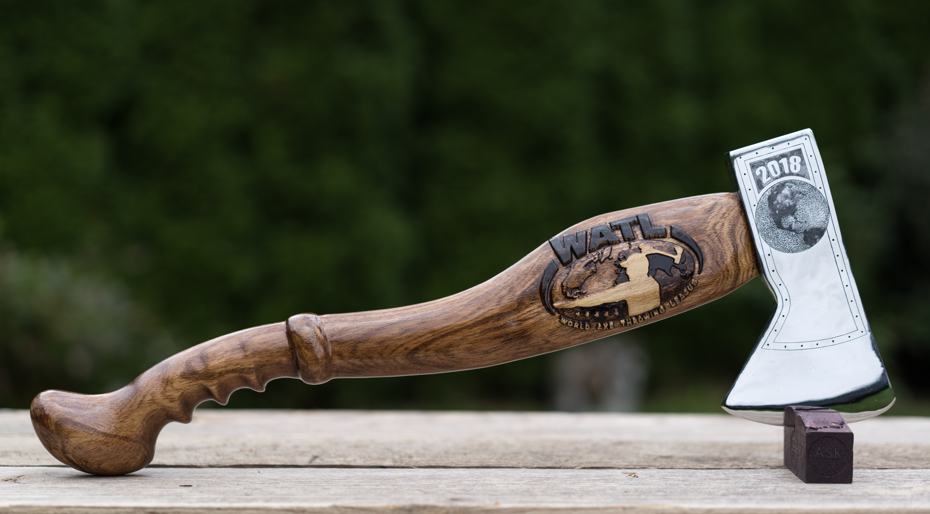

Road to the championship
Concept
Objective
Gameplay
Development Time
Summary & Capitalization

Slide 3
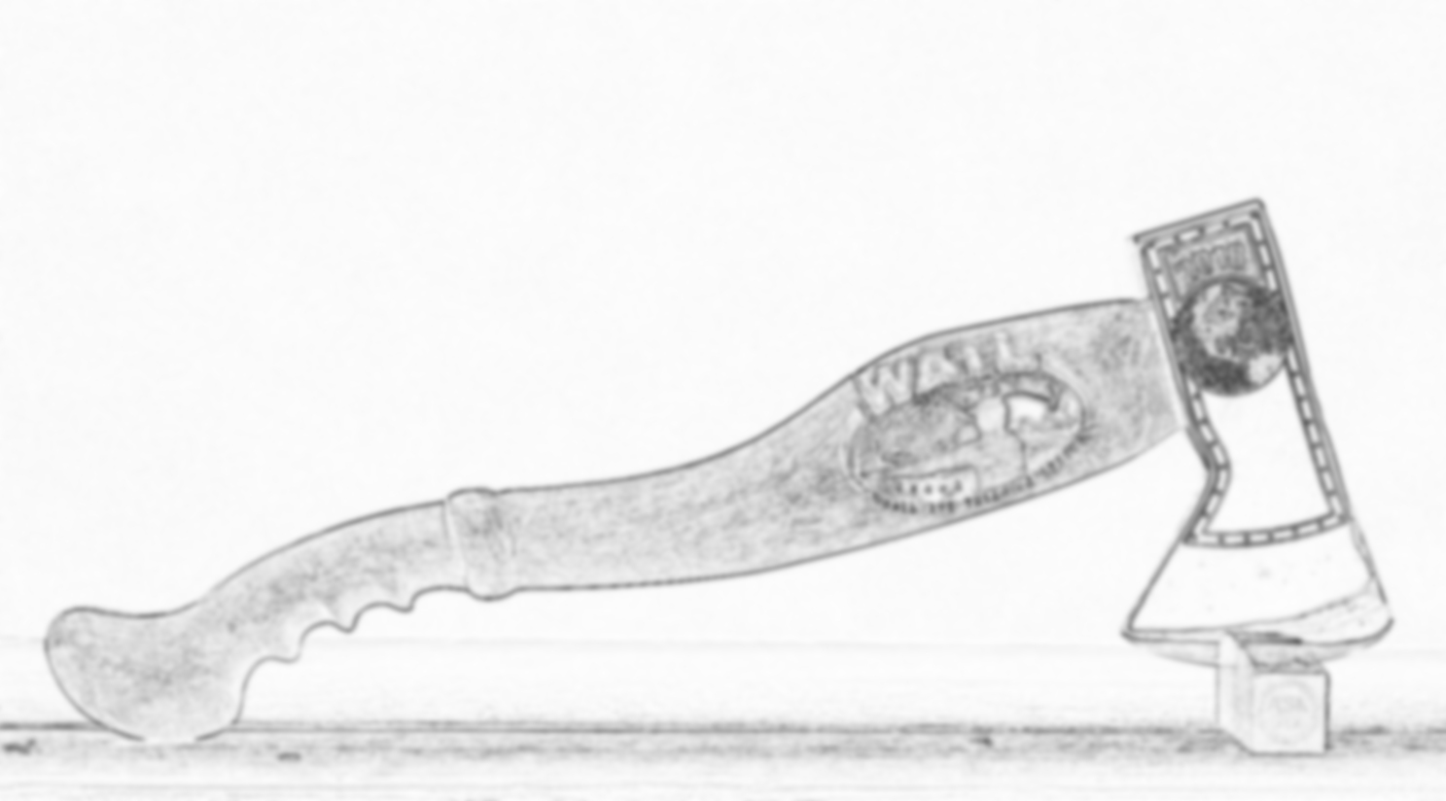
Concept
A game of axe throwing – the new sport that's sweeping the nation
Solely on mobile, it will cater to both the casual and dedicated gamer
Implementing an online leaderboard so players can compete against each other worldwide
This game idea applies the same fundamental approachability that anyone can throw axes and have fun. It will fall in line with the ideals of the World Axe Throwing League and connect similar minded people worldwide to foster competitive gaming

Slide 4
Objective
To create a fun, addicting game by means of a unique activity mimicked in the virtual realm.
The goal for this game is to provide niche entertainment by means of action, competitiveness, skill development and active customization.
Some proposed features for this game include:
Competitive Leaderboards and Face-Offs
Unlockable axes, environments and themes – may be purchased with in game currency or in-app purchases ;)
3 different game modes: Tournament Play, Face-Off and Practice.
There is a plethora of other modes and an endless amount of unlockable concepts to keep this game alive for years to come

Slide 5
Gameplay
This game will emulate the real game: like Darts but with Axes
Swipe controls – think 'paper toss' on mobile platforms!
Once you run out of axes to throw, the round is over
Your score is tallied in a local all-time high score, and scores by season to compare against the world leaderboards
After each round, the environment slightly changes to reduce play fatigue

Slide 6
Development Time
The projected development time for release is roughly 3 months with a team of 3 devs
With an appropriate timeline, the development could be finished earlier barring the desired 'juice'

Slide 7
Summary & Capitalization
To summarize, this is a game like some others, with one fundamental advantage
The concept alone falls in line with the 'new' factor of the real-life sport
The development deadline will take advantage of this year's World Axe Throwing League championship (December) - being broadcasted on ESPN for the first time in the history of the sport
The opportunity to reach a widespread audience on that alone is enough to sell this concept, but there's one more concept that will more or less guarantee conceptual success:
It's a symbiotic working relationship between the organization and the studio:
'FREE' MARKETING

